Slide 1


A
Presentation
On
“Home security system ”
SUBMITTED TO:
Mr./Ms. Mentor Name
Rajesh Bathija
SUBMITTED BY:
Team Name :- Developers Squad

Slide 2

CONTENTS
Problem Statement
Idea/Solution
Objective of the project
Users of the project
Main components
Tools and Technologies
Screenshots
Key Learning
Conclusion

Slide 3
Problem Statement
Create Smart home hardware hack based on IOT

Slide 4
Ideas/Solution
Security is a big challenge everywhere because thefts are increasing day by day owing to the unsafe and insecure security systems in homes, commercial complexes and industries. Several conventional technologies are available to keep home properties safe from intruders, but most common smart home security systems work on wireless GSM communication. Such systems provide security from natural, incidental, intended, unintended, accidental and human made problems by continuously monitoring homes with different sensory systems like motion, smoke, gas, temperature, glass break or door break detectors and fire alarm systems.

Slide 5
OBJECTIVE
Our objective is to build an easy to install and low cost smart home security lock system with the function of RF ID access and remote lock control through mobile devices. We aim to maximize security and optimize convenience in order to provide a safe and comfortable home security.
That too on easy affordability and Availability. The main purpose we serve behind this is
>>> With the advanced development of internet computing, various systems
can be easily accessed and remotely controlled through mobile devices.
>>> In this era self-build make it possible to solve the current security lock system has three main problems
which are insecure, unawareness of break-ins and inconvenience by ourselves by using home automation technologies.

Slide 6
‌PURPOSE SERVED
Conventional lock is easy to lock picking and leaves home vulnerable to break-ins. Second, the home owners are often unware their homes are being break-in when they are at work or away from home. Lastly, physical keys are bulky and inconvenient to carry. To solve these issues, we have developed an inexpensive smart home security lock system using RF card as the main access of the door, a web- based control and notification system .
That can trace, secure and make our Security issues a lot less vulnerable.

Slide 7

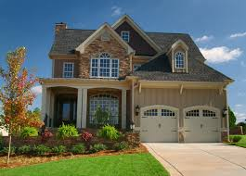


Users of the Project
offices
homes
Hospitals
Banks

Slide 8
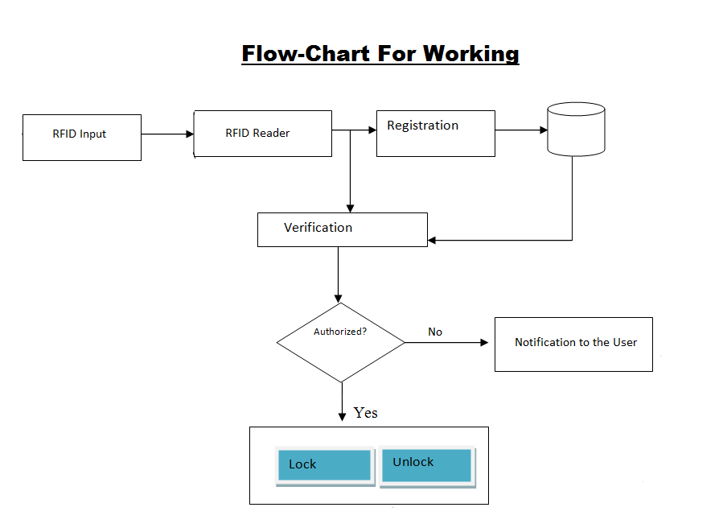
Main Components
Arduino Board
RF module
Raspberry Pi
Motor

Slide 9
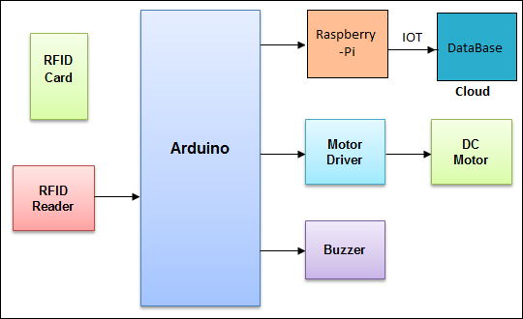
Tools and Technologies
Embedded C
Python
RF id
Raspberry Pi
Sever Handling
Databases

Slide 10
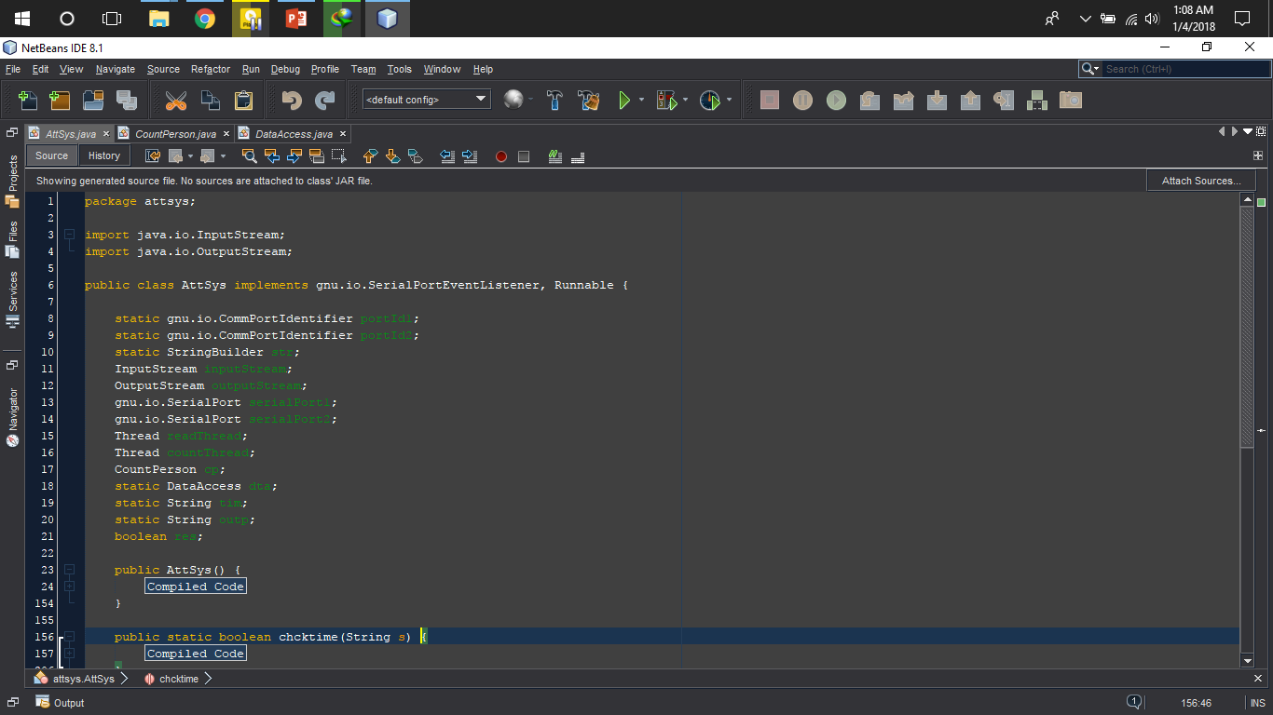
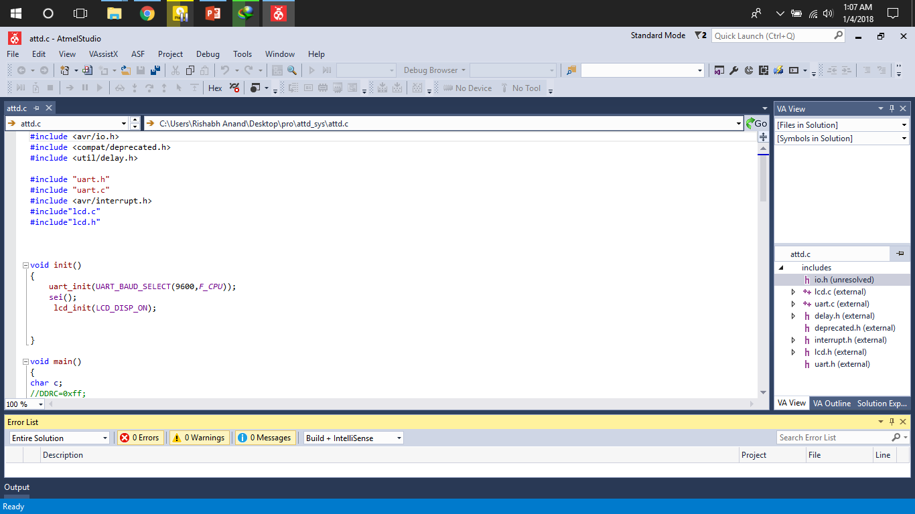
Screenshots

Slide 11
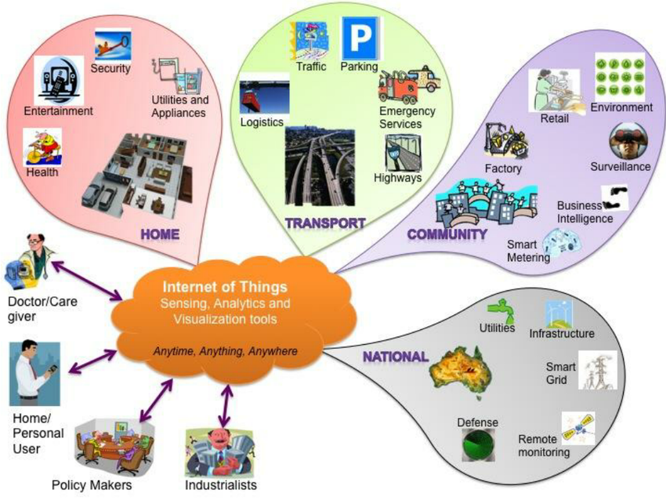
Key Learning
In this project
We can learn how IoT can be used in security systems.
Basics of IOT
Working on Embedded python
Handling Servers
Working on Databases

Slide 12
Conclusion
We investigated the security vulnerabilities on the smart home appliances from examining smart lock by leveraging reverse engineering. We analyzed the security of the smart lock system comprehensively, and demonstrated attacks toward the system by exploiting the normal lock system. We then provided the corresponding defense suggestions for the smart lock. We proposed to provide security mechanisms for the smart home appliances in general at multiple levels to ensure the security of smart devices, including the RF ID system, and smart home appliance hardware. In future work, we plan to investigate other types of IoT devices, and develop a holistic security framework to secure the IoT systems.

